Slide 1


New Forest National Park
Local Plan Review
NFALC Briefing - 21 April 2016
Steve Avery – Executive Director, Strategy & Planning

Slide 2
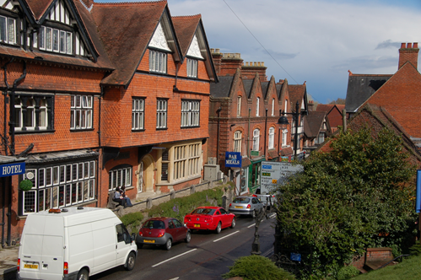

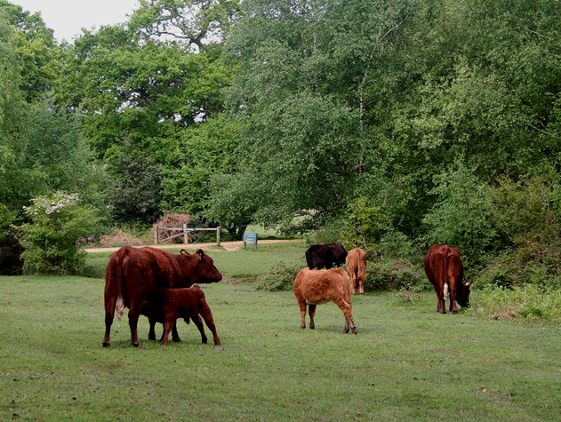
This evening…
Local Plan Review
Legislative background
National Planning Policy
Key issues for the Forest
Beyond the boundary

Slide 3

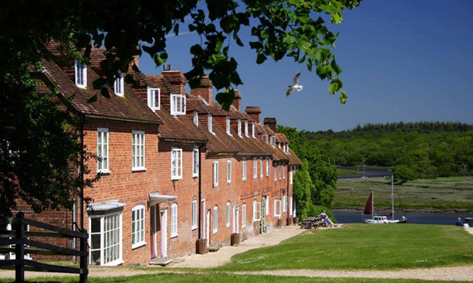
Current Local Plan
Adopted in 2010
Subject to extensive public consultation
Very positive endorsement at Examination
Policies have been supported very well on appeal
Notes:
Governments budget statement – July 2015 …if a plan is not addressing the need for the jobs and houses needed locally the Secretary of State will intervene and arrange for Local Plans to be written….

Slide 4
Stages in the Local Plan review
Summer – Autumn 2015
Early consultation inviting views on what matters the Local Plan review should address
Spring - Summer 2016
Community and public engagement in developing revised policies
Winter 2016/17
Examination by the Secretary of State and then adoption following publication of Inspector’s Report
Autumn 2016
Publication of proposed ‘Submission Draft’ document for formal consultation and then submission to Government

Slide 5
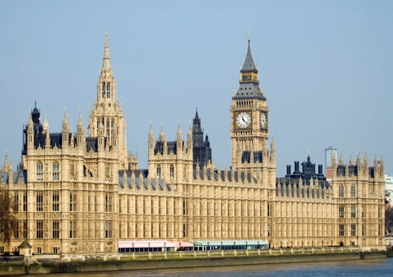
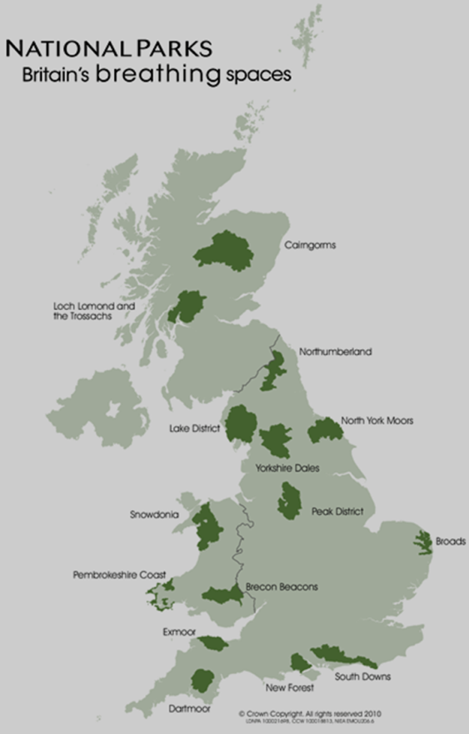
Legal Background
The Town and Country Planning Act 1990 requires all LPAs to produce a Local Plan for their area
The Environment Act 1995 legally established independent NPAs for all National Parks to deliver the two statutory purposes

Slide 6
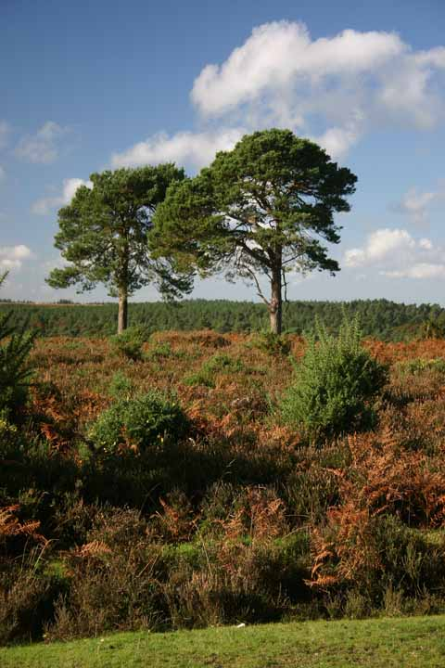
The two purposes and duty…
To conserve and enhance the natural beauty, wildlife and cultural heritage of the Parks; and
To promote opportunities for the understanding and enjoyment of their special qualities by the public
“…to seek to foster the economic and social well-being of local communities within the National Park.”
Notes:
The Environment Act 1995

Slide 7
National Planning Policy
Localism Act 2011
National Planning Policy Framework 2012
Abolition of Regional Planning 2013
National Planning Practice Guidance 2014
Greater permitted development rights
Housing and Planning Bill 2015

Slide 8
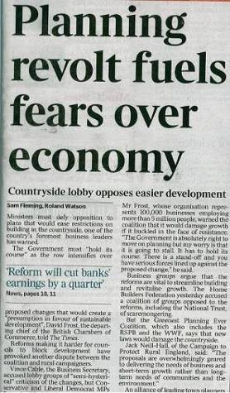
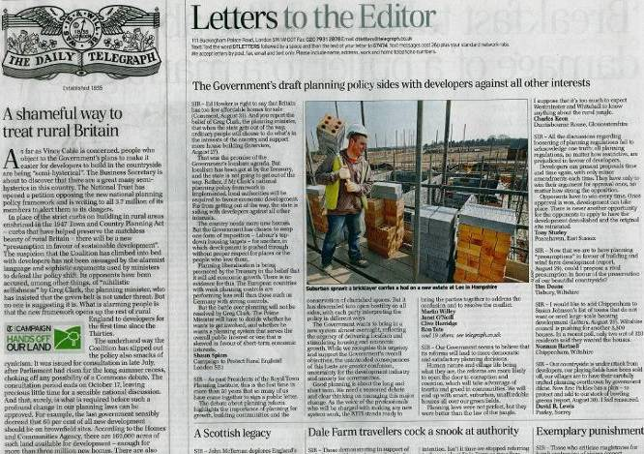
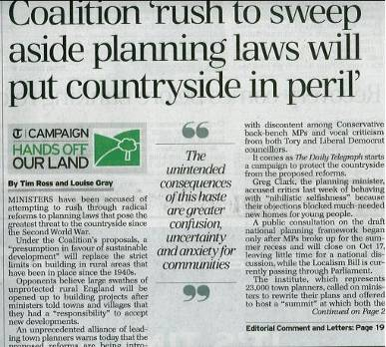
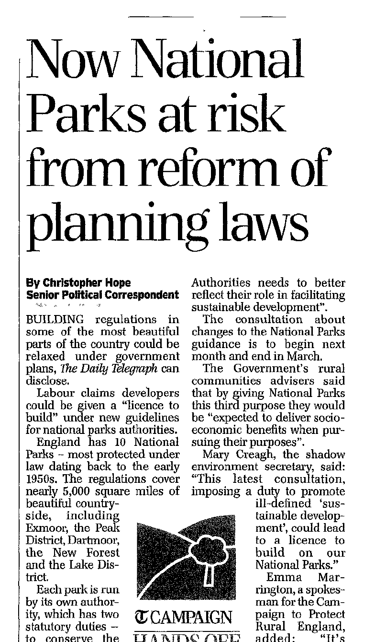
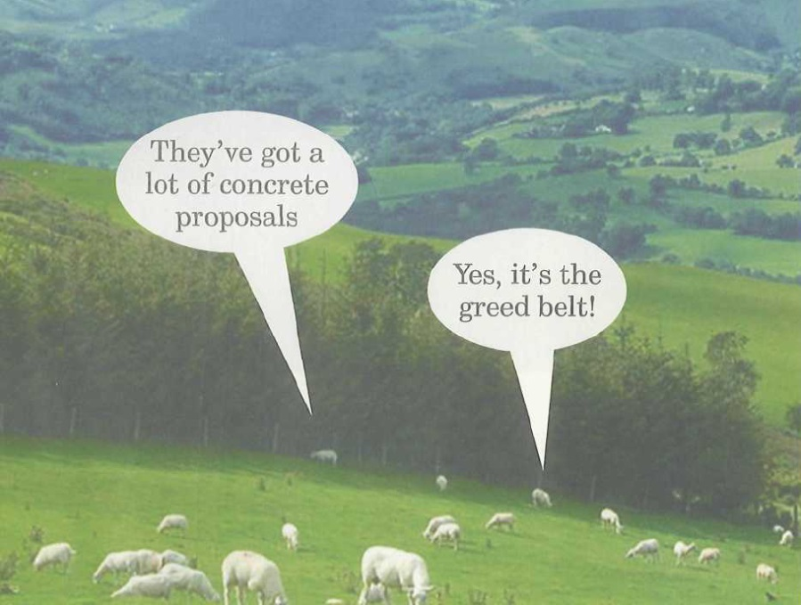
Notes:
8
Planning in the news as never before. 15 consecutive days in Daily Telegraph in September.
Good – because people are talking about planning and housing.
Bad – because it’s a very polarised debate. Mainly focussed around the countryside and Green Belt,
Between – Treasury/politicians – focussed on growth, the development industry and freer market for land use vs the National Trust/CPRE lobby, united by the Daily Telegraph in their Hands off our Land campaign

Slide 9
National Planning Policy Framework
The presumption in favour of sustainable development recognises National Parks as areas where development should be restricted
Great weight should be given to conserving landscape and scenic beauty in National Parks which have the highest status of protection in relation to landscape & scenic beauty

Slide 10
Key issues for the Forest
Meeting local housing needs
Sustaining a diverse and vibrant rural economy
Conserving and enhancing a nationally protected landscape
  managing recreational/visitor pressures
  supporting commoning and traditional land management practices
Notes:
1st two focused on s/e duty / local communities
Part of conserving is managing recreational pressures

Slide 11
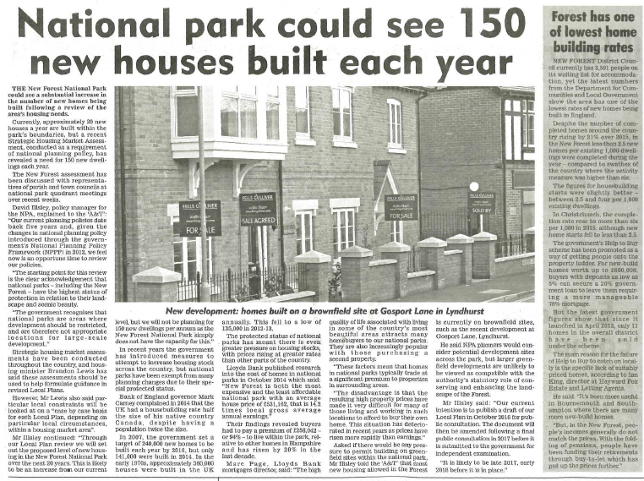

Slide 12
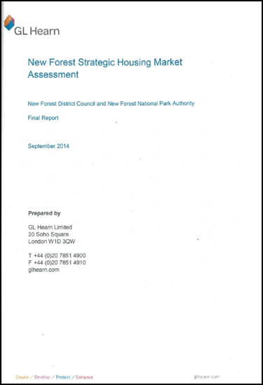
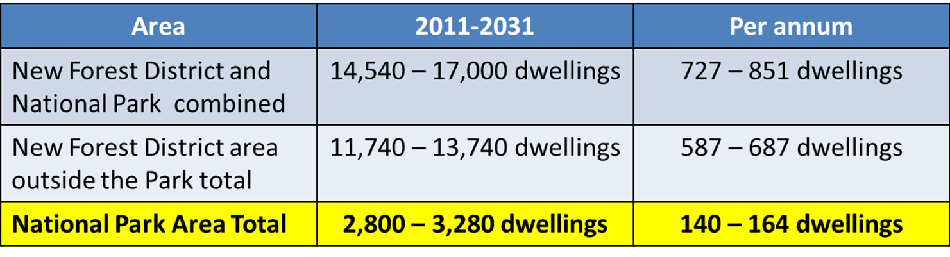
Meeting local housing needs
All planning authorities – including National Park Authorities - are required to plan positively to meet their identified needs as far as is consistent with other policies in the NPPF.

Slide 13
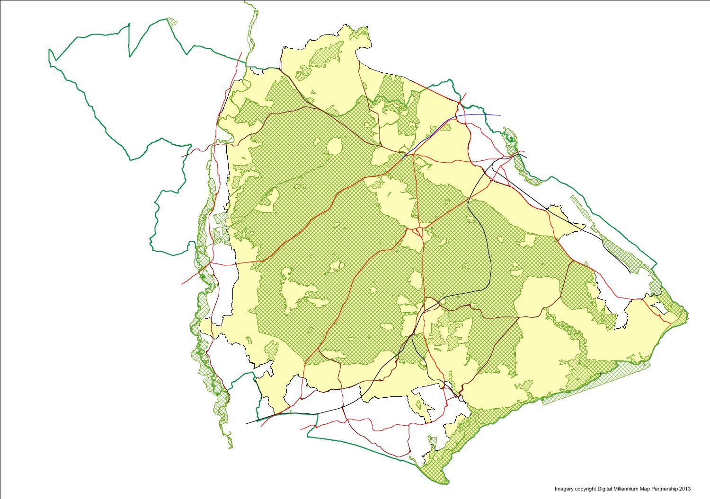
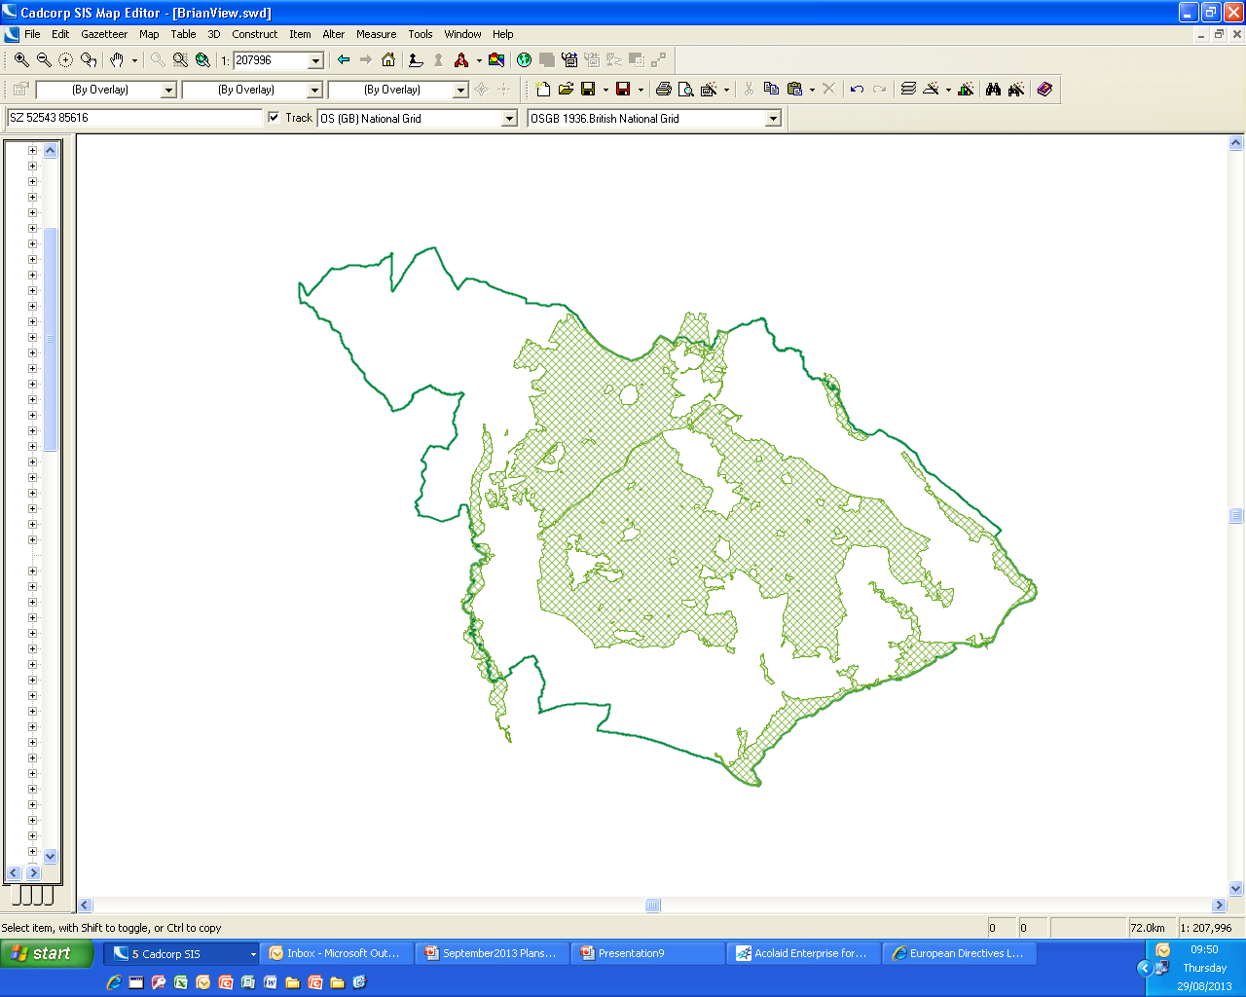
New Forest District Council Boundary
New Forest National Park Authority
Totton
Fordingbridge
Cadnam
Lyndhurst
Hythe
Ringwood
Fawley
Burley
Brockenhurst
Beaulieu
New Milton
Lymington
SPAs & SACs
Milford on Sea
European Union Habitat Directive

Slide 14

Meeting objectively assessed housing needs
“…the outcome of a Strategic Housing Market Assessment is untested and should not automatically be seen as a proxy for a final housing requirement in Local Plans. It does not immediately or in itself invalidate housing numbers in existing Local Plans.”
“Councils will need to consider Strategic Housing Market Assessment evidence carefully and take adequate time to consider whether there are environmental and policy constraints, such as Green Belt, which will impact on their overall final housing requirement.”
Brandon Lewis MP, Minister of State for Housing & Planning, December 2014

Slide 15
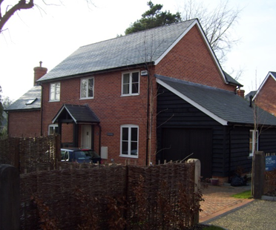
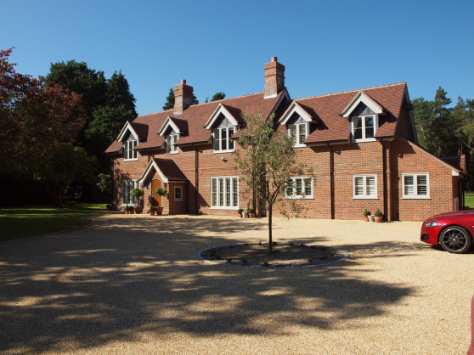
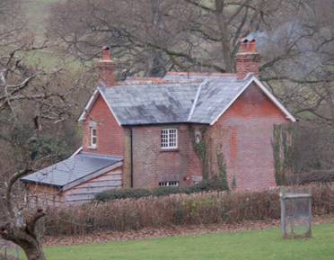
Housing in the National Park
Settlement hierarchy
  Defined Villages
Affordable Housing
Commoners Dwellings
Replacement Dwellings
Small dwellings and the “30% rule”
Local Distinctiveness

Slide 16
Rural economy
Protection of employment sites
Local food producers
Re-use of farm buildings
Hotels
Camping and caravanning
Estate Plans

Slide 17
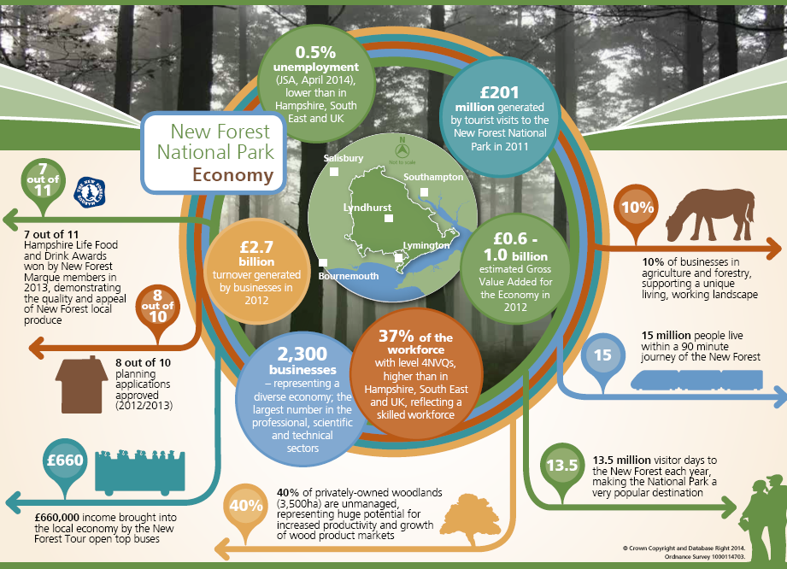

Slide 18
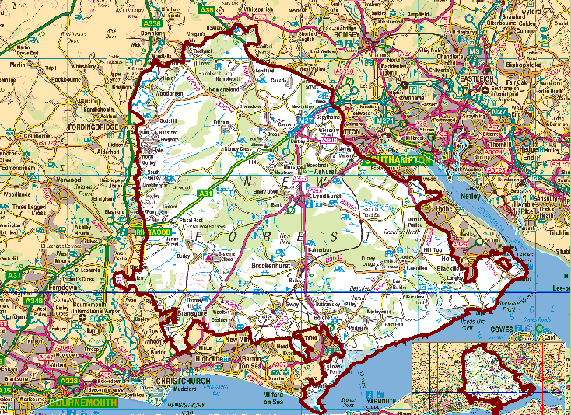
Beyond the boundary
Airspace extension
Airport expansion
80,000 additional dwellings in South Hants
Increasing traffic volume and noise
Mineral works
Potential future port development Dibden Bay
Recreation pressures
Fawley Power Station
35,000 additional dwellings in SE Dorset
Rising sea levels

Slide 19

Beyond the boundary
S62 duty – requirement for “relevant authorities” to have regard to the purposes of National Parks “in exercising or performing any functions”
Duty to cooperate

Slide 20
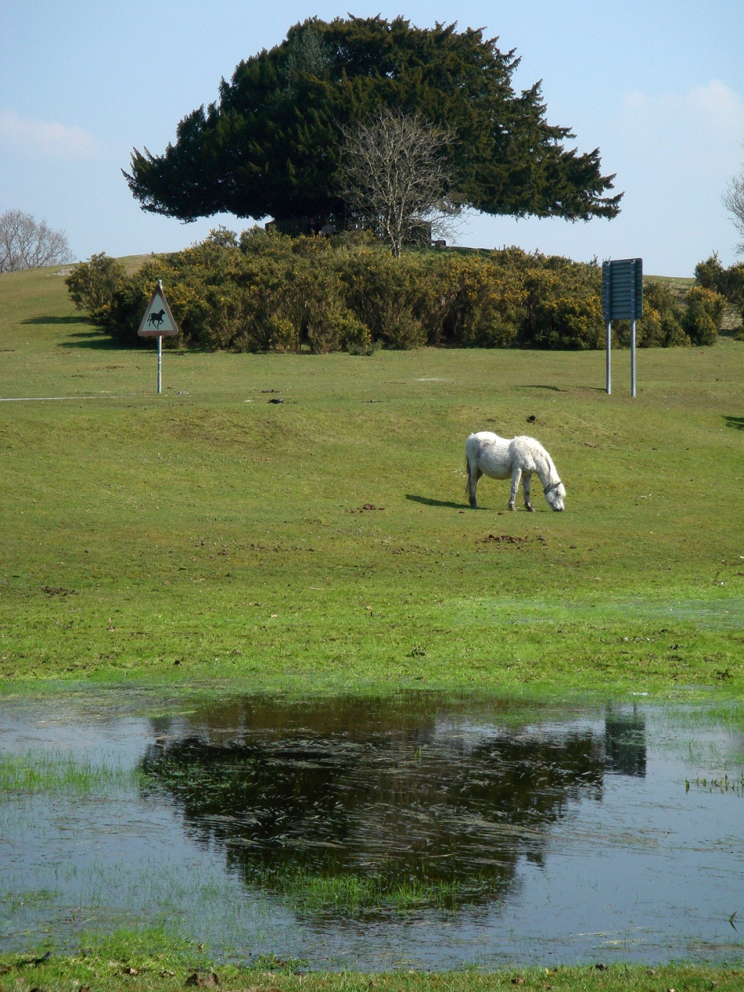
Beyond the boundary
Working closely with adjoining local planning authorities, especially NFDC
Need to review habitat mitigation measures linked to the scale of development
Joined up approach to Green Infrastructure

Slide 21
Other issues
SPDs
  Design Guide
  Development Standards
  Horse keeping guidelines
  Village Design Statements
Neighbourhood Plans
Community Infrastructure Levy (CIL)

Slide 22
Next steps…
Outcome of Planning & Housing Bill
Conclude assessment of sites put forward in response to “Call for Sites”
Further workshops:
  Defined Villages
  Estate Housing
  Green Infrastructure
Draft plan presented to Authority meeting on September 2016

Slide 23
New Forest National Park
Local Plan Review
NFALC Briefing - 21 April 2016
Steve Avery – Executive Director, Strategy & Planning

